Slide 1


Team World Wide
Big Data Hackathon

Slide 2
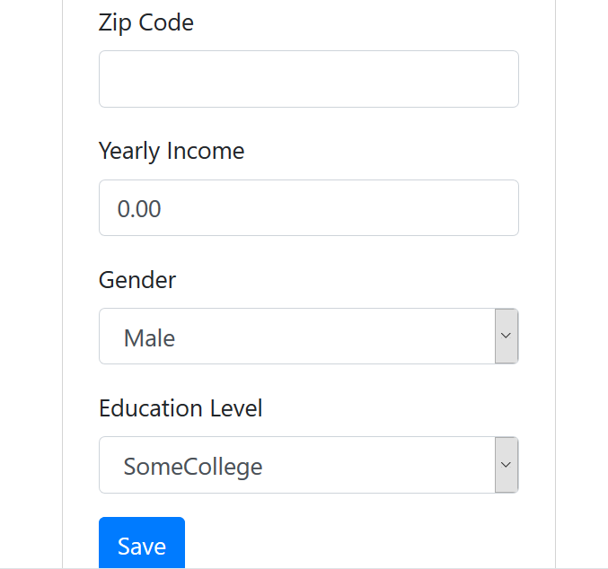
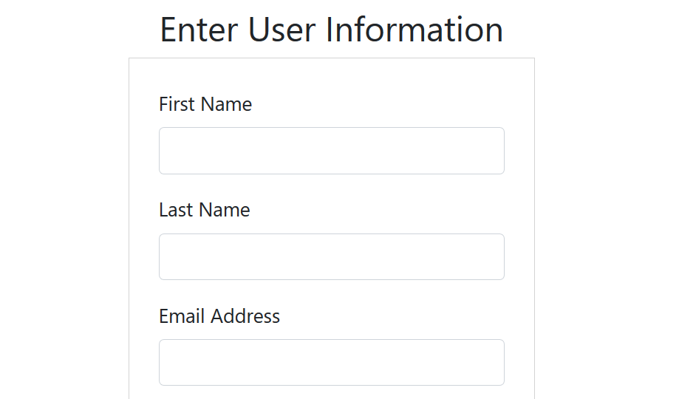
Idea behind Web Application

Slide 3
Idea behind Web Application
https://github.com/JM-GITHUB-23/BigData
This web application was supposed to allow users to enter their personal data and then have relevant transportation and money estimates pulled.
The goal was to combine personal commute data with information from various datasets and perhaps even google maps to show estimated costs to the user.
Some of the estimated costs
* estimate time stuck in traffic
* estimate mileage costs
* health costs
* carbon footprint
We also wanted people to use the application for checking which street parking spaces were available.

Slide 4
Data
The data was from around Downtown San Diego area.
We used the transaction time and transaction amount (in cents) to check how long people are typically staying for based on time of day.
We hoped that we could change the parking meter’s max time or price to increase flow.

Slide 5
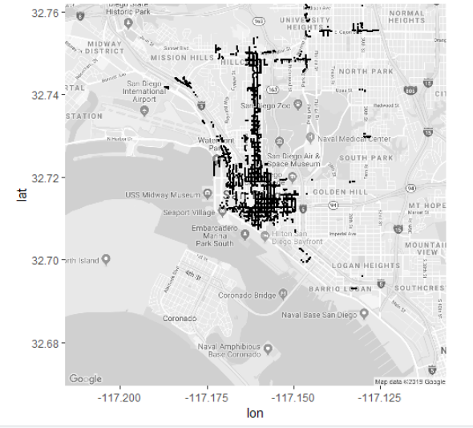

Slide 6
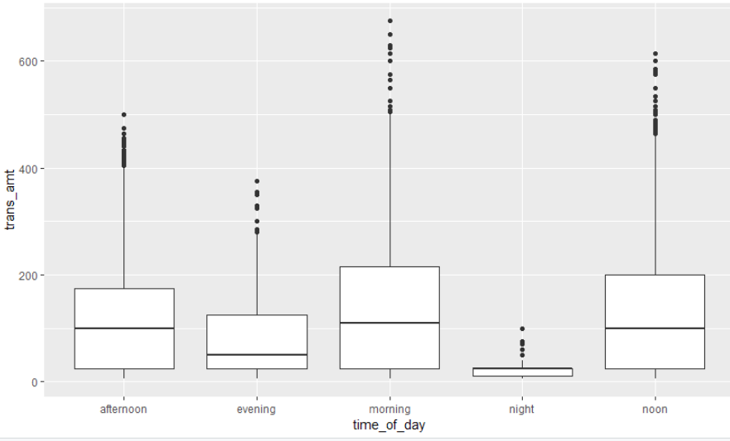

Slide 7
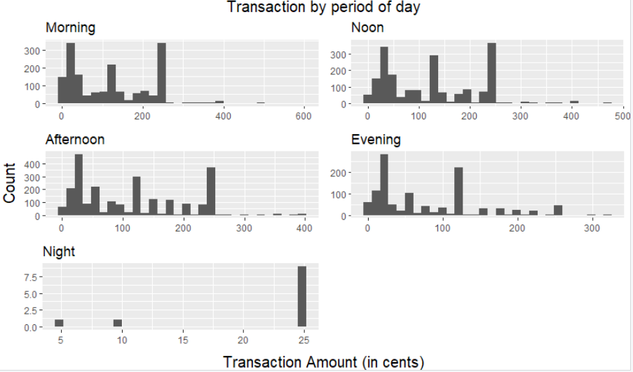

Slide 8
Average of transaction amount in the morning
121.7834
Average of transaction amount in the noon
119.1045
Average of transaction amount in the afternoon
113.4936
Average of transaction amount in the evening
81.42927
Average of transaction amount in the night
20.2761

Slide 9
Using this, we may be able to exponentialize pricing or reduce max parking times to create a better flow.
We also wanted to analyze which part of town needs more parking spaces based on the availability and popularity of the current parking meters.
Using this, we may be able to find which part of town requires electric charging spots.

